Slide 1
JOURNAL CLUB- DASIGLUCAGON
BY
DR.G.AARTHIPRIYANKA
POST GRADUATE
DEPARTMENT OF PHARMACOLOGY

Slide 2
dasigluCaGon- DESCRIPTION
- dasiglucagon hydrochloride.
- glucagon analogue.
- hyperglycaemic agent
- 29 amino acids.

Slide 3
WHY NOT GLUCAGON?
Glucagon – 26 aminoacids
Anti-hypoglycaemic agent
DASIGLUCAGON – 7 AMINOACIDS are substituted
- Stable in aqueous solution
- ready to use

Slide 4
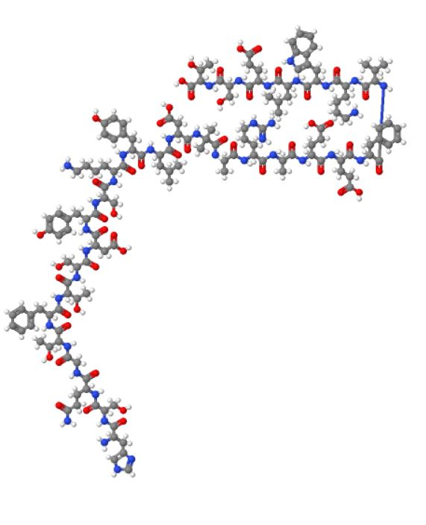
CHEMICAL DESCRIPTION
MOLECULAR FORMULA:
C₁₅₂H₂₂₂N₃₈O₅₀
molecular mass - 3382 g/mol.
STRUCTURAL FORMULA:
Dasiglucagon - 29 amino acids.

Slide 5
dasiglucagon
Anti hypoglycemic agent
INDICATION:
For hypoglycemia in pediatric (> 6 years) & adult diabetic patients.
Approved by FDA on March 2021.

Slide 6
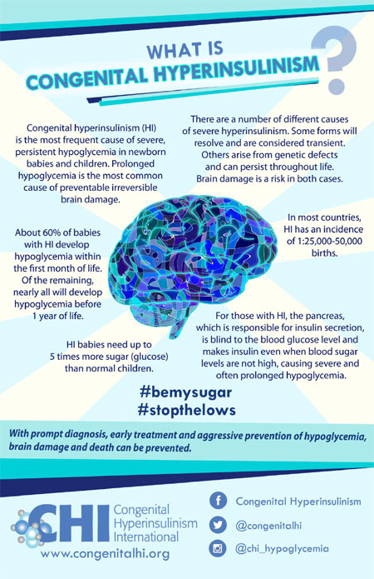
ORPHAN DRUG in 2017
Notes:
Orphan drug in 2017

Slide 7
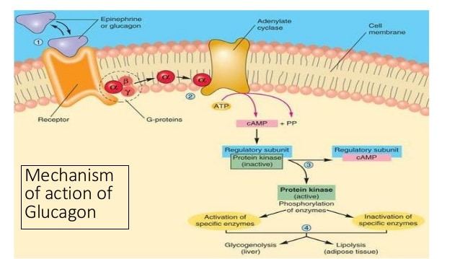

Slide 8
MECHANISM OF ACTION
glucagon receptor agonist,
activating hepatic glucagon receptors,
stimulating glycogen breakdown
release of glucose from the liver.
Hepatic stores of glycogen
are necessary

Slide 9
PHARMACOKINETICS
Administration :subcutaneous injection of 0.6 mg.
Distribution :Apparent volume of distribution- 47 L to 57 L.
Elimination : half-life - 30 minutes.
Metabolism : cleared like native glucagon through proteolytic degradation pathways in blood, liver, and kidney.
ADULTS CHILDREN
mean peak plasma concentration 5110 pg/mL 3920 pg/mL
At 35 minutes. At 21 minutes

Slide 10
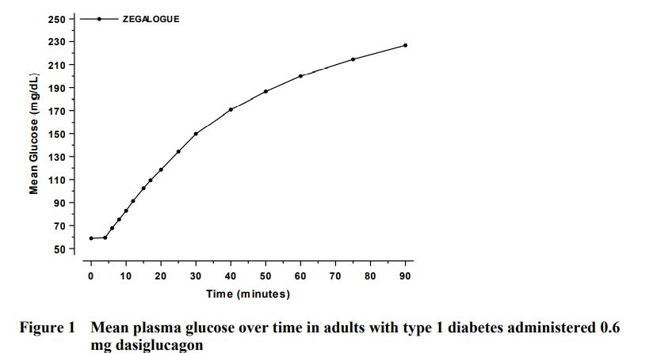
PHARMACODYNAMICS

Slide 11
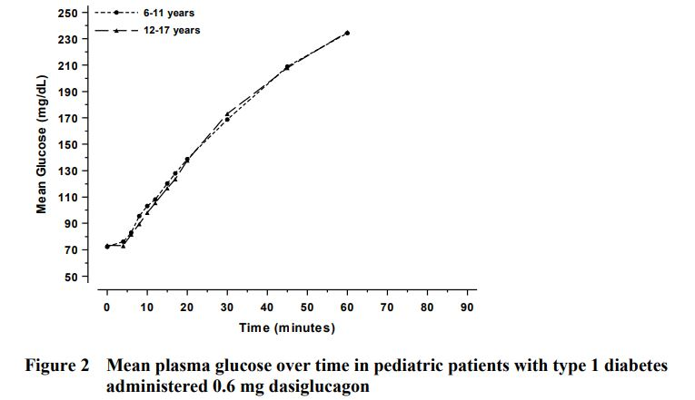
PHARMACODYNAMICS

Slide 12
DOSAGE FORMS AND STRENGTHS
• 0.6 mg/0.6 mL single-dose autoinjector/prefilled syringe.
• That is 1mg/1ml – Subcutaneous route.

Slide 13
CONTRAINDICATIONS
• Pheochromocytoma.
• Insulinoma.

Slide 14
DRUG INTERACTIONS
Beta blockers
Indomethacin
warfarin

Slide 15
CLINICAL STUDIES
Three randomized, double-blind, placebo-controlled, multicenter trials were conducted in patients with type 1 diabetes.
Two trials - Trial A and Trial B - adult patients,
one trial - Trial C - 6 to 17 years.
Trial A – 170 patients
Trial B - 45 patients
Trial C - 42 patients
Trial A & Trial C - 2:1:1 -randomized to DASIGLUCAGON 0.6 mg, placebo, glucagon for injection 1.0 mg.
Trial B - 3:1 -patients were randomized to DASIGLUCAGON 0.6 mg, placebo

Slide 16
median time to plasma glucose recovery
Trial A – DASIGLUCAGON - 10 minutes
placebo - 40 minutes
GLUCAGON - 12 minutes
Trial B - DASIGLUCAGON - 10 minutes
placebo - 35 minutes
Trial C – DASIGLUCAGON - 10 minutes
placebo - 30 minutes
GLUCAGON - 10 minutes

Slide 17
ADVERSE REACTIONS
ADULTS & CHILDREN:
Nausea
Vomiting
Headache
Diarrhea
Injection site pain

Slide 18
Immunogenicity
As with all therapeutic peptides, there is a potential for immunogenicity with Dasiglucagon.
In clinical trials, 4/498 (<1%)of DASIGLUCAGON-treated patients developed treatment-emergent anti-drug antibodies (ADAs).

Slide 19
USE IN SPECIFIC POPULATIONS
Pregnancy -no available human data on dasiglucagon.
In animal reproduction studies - No adverse fetal developmental effects were observed.
Lactation – no human data available
Pediatric Use- safe above 6 years
Geriatric Use- no difference in drug response
Carcinogenesis- no human data available
Mutagenesis- not mutagenic
Impairment in fertility- no impairment of fertility in animal studies

Slide 20
PHARMACOECONOMICS
Available in US
$10 to $630 (single shot/multiple doses).

Slide 21
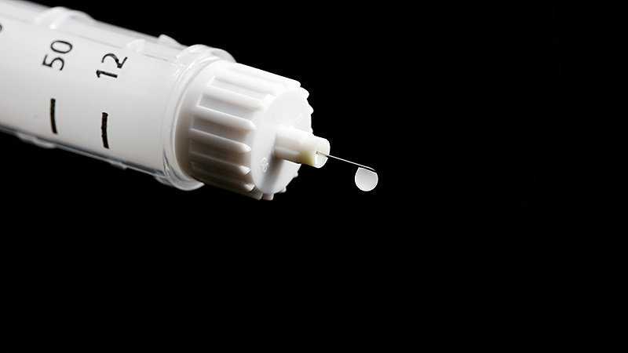
Thank you

